Slide 1
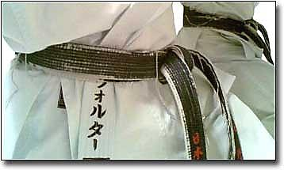
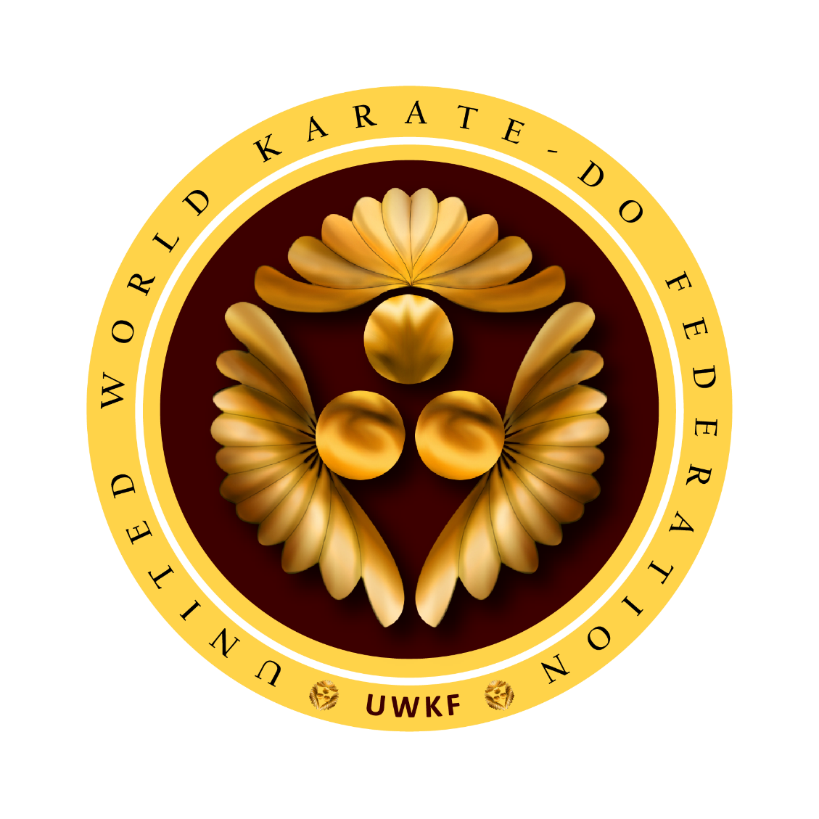
United World Karate-do Federation Uniting All Styles and Formats of Karate-do in a Single WF “On Ko Chi Shin” To search for the old is to understand the New

Slide 2
“Karate world can not be unified
the same way as has been attempted for the last 45 years.
Well researched pragmatic ideas alone could bring a truly unified structure where the art of karate-do thrives as one of the most important tools for human development in the present complex world”.
Imtiaz Abdulla – Rajeev Sinha
Surviving Active Members of
IOC Recognized JWC that was set-up in 1996

Slide 3
Unification Audit Report
Prague Declaration of November 30, 2013
The only surviving and active members of the Joint Working Committee (JWC) that was established on 29 June 1996 in Osaka, Japan and subsequently recognised by the International Olympic Committee (IOC) on July 11, 1996, presented the Audit Report of the past 17 years before the assembly of 54 countries on November 30, 2013 during WFF Championship in Prague.
The Audit Report presented jointly by Mr. Imtiaz Abdulla and Mr. Rajeev Sinha reflected the frustration created by the unsuccessful and sometimes illegal and non-inclusive process. It was resolved that other structures will be consulted and included to truly achieve Karate unity globally.

Slide 4
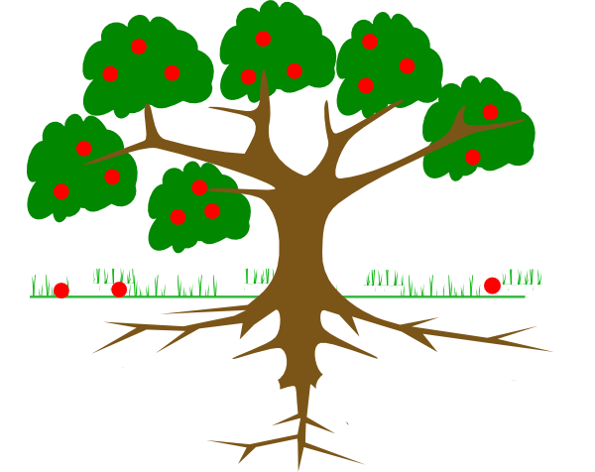
Fertilize the Roots, Tree shall Grow
After evaluating and auditing the processes of the last 20 years which includes the IOC decisions, the attempts to unify all karate and unsuccessful bid by the WKF to have Karate included in the 2016 and 2020 Olympics, JWC has come to an unbiased conclusion that the World Karate fraternity which had mandated the JWC to act on its behalf to present a process that was fair and reasonable, has been deprived of their constitutional right to have karate unified.
Accordingly, new strategy was drawn and the origin of karate was revisited to honour the surviving masters of 2nd and 3rd generations in Japan and worldwide to show the unified path to the rest of the world.

Slide 5
Thus begins the Journey
Towards Unified Karate
United World Karate-do Federation Uniting All Styles and Formats of Karate-do in a Single WF

Slide 6
History Of UNITED WORLD KARATE FEDERATION A task difficult but not impossible
The United World Karate Association was created in Tokyo, Japan by Sosai Chodoin Daikaku in 1992 after karate lost its recognistion by the International Olympic Committee;
After supporting the efforts of the unification of styles in Japan, we achieved this in 2015, with 5 recognised styles, Shotokan, Wado, Goju and All Full Contacts ryus in one organization – called the Karate-Do Imoto Kaigi
See more at: www.japantimes.co.jp/life/2009/07/09/people/united-world-karate-association-president-daikaku-chodoin-2/#.VUMz1ufxbEN

Slide 7
First Unify Japan, the World shall follow the Masters A task difficult but not impossible
Karate can not be treated at par with other sports because of its master & style-centric characteristics
Major styles and their Masters are to be Unified in Japan first followed by worldwide unification of all the styles
Each country to follow the path where the code of “Budo” amalgamates with sporting principles

Slide 8
Japan Unifies
In a historic meeting held in Tokyo initiated by Imtiaz Abdulla Shihan from April 2 to 8, 2015, major karate
styles and legendary Japanese masters unify under single World Organisation – UWKF, United World Karate-do Federation, under the leadership of Sosai Chodoin Daikaku

Slide 9
UWKF – Karate-do Taishiya Karate-do Shrine that will house the legacy of Founders
Resolved to establish Shrine in Japan (Karate-do Taishiya) that shall be the headquarters of UWKF and house the glorious history of Masters who were the founders of different styles of karate-do.

Slide 10
Karate-do Soke Imoto Kaigi Disciples of the Founders of Karate-do
Resolved to establish Karate-do Soke Imoto Kaigi (Founders Association that includes only those 3rd generation masters who were disciples of the Founders of Karate-do, that is O-senseis Gichin Funakoshi, Chojun Miyagi, Kenwa Mabuni, Hironori Otsuka, Masatatsu Oyama) in Japan

Slide 11
Surviving Masters who trained under the Founders
of Shotokan, Goju-ryu, Shito-ryu, Wado-ryu & Kyokushin
Soke Imoto Kaigi from Eastern World
Hanshi Hirokazu Kanazawa (Shotokan)
Hanshi Morio Higaonna (Goju Ryu)
Hanshi Kenei Mabuni (Shito Ryu)
Hanshi Toru Arakawa (Wado Ryu) (passed away on 21 June 2015)
Hanshi Masayu Sugihara (Kyokushin)

Slide 12
Karate Style Ryu-ha Blocks Blocks of Styles Worldwide to be Unified
Shotokan
All Groups of Shotokan and Shotokan based groups
Goju Ryu
All Groups of Goju Ryu and Goju based groups
Shito Ryu
All Groups of Shito Ryu and Shito based groups
Contact Karate
All Groups of Kyokushin and Kyokushin based groups. Koshiki and Koshiki based groups
Wado Ryu
All Groups of Wado Ryu and Wado based groups

Slide 13
Recognised Groups for Unification under Shotokan Block
Shotokan Groups with traceable lineage
JKAWF
JKA International
SKIF Shotokan Karate International Federation
ISKF International Shotokan Karate Federation
JKS Japan Karate Shotorenmei
WSI World Shotokan Institute
WFF World Fudokan Federation
KWF Karatenomichi World Federation
JSKA Japan Shotokan Karate Association
WSKF World Shotokan Karate-do Federation
Others
Other groups with traceable technical lineage shall be screened shortly - such groups should have its presence in minimum of 25 countries

Slide 14
Recognised Groups for Unification under Goju Ryu Block
Goju Ryu Groups with traceable lineage
Others
Other groups with traceable technical lineage shall be screened shortly - such groups should have its presence in minimum of 25 countries
IOGKF
Kenbu Kai
GojuKai
Kenshi Kai
Ujiage Kai
Seiwa Kai
Rengokai
Jundokan
OGKK
Okinwan Goju Ryu

Slide 15
Recognised Groups for Unification under Shito Ryu Block
Shito Ryu Groups with traceable lineage
Inoue Ha
Others
Other groups with traceable technical lineage shall be screened shortly - such groups should have its presence in minimum of 25 countries
Kuniba Kai
Hayashi Ha
Shitokai
Shukokai
Seishin Kai
Kenshin Kai
Rembu Kai

Slide 16
Recognised Groups for Unification under Wado Ryu Block
Wado Ryu Groups with traceable lineage
Wado Kai
Others
Other groups with traceable technical lineage shall be screened shortly - such groups should have its presence in minimum of 25 countries

Slide 17
Recognised Groups for Unification under Contact Block
Contact Karate Groups with traceable lineage
Shinkyokushin
Others
Other groups with traceable technical lineage shall be screened shortly - such groups should have its presence in minimum of 25 countries
Kyokushin World Union
World Kumite Organization
Kyokushinkaikan
IKF
World Kumite Organization
Koshiki Karate All Groups

Slide 18
UWKF Board
Board of Directors
President
Execuitive Chairman
Chairman PR and Media
Executive Director
Chairman Hanshi Kai
Chairman Culture and History
Ilija Jorga
Sosai Daikaku Chodoin
Imtiaz Abdulla
Rajeev Sinha
Spataco Bertoletti
Florentine Marinuscu
Europe Representative
African Represntative
Jack Mbom
From JWC
From JWC
Danielle Lazzirini
From Full Contact Block
UWKA Founder

Slide 21
Comparison of Sport Accord & UWKF Boards
ASOIF
Association of Summer Olympics International Federations
AIOWF
Association of International Olympics Winter Sports Federations
ARISF
Association of Recognised International Sports Federations
AIMS
Alliance of Recognised Independent Members
Nominee of Associate Members
UWKF
United World Shotokan Karate-do Nominees
United World Goju Ryu Karate-do Nominees
United World Shito Ryu Karate-do Nominees
United World Wado Ryu Karate-do Nominees
United World Contact Karate-do Nominees

Slide 22
UWKF Tournament Formats
TOURNAMENT FORMATS
United General Karate
United Traditional Karate
United Contact Karate
Rules of General Karate Technical Commission
Rules of Traditional Karate Technical Commission
Rules of All Contact Karate Technical Commission

Slide 23
UWKF Administration and Governance
Executive Chairman
Finance
Sponsorship
Finance
Activities
Championship, Conventions, Seminars, other
Karate Diplomacy

Slide 24
World Structure and distribution of Countries | National Federation 5 styles 3 competition formats one organization
4 continental structures
Africa
Europe
Asia/ Oceania
America
UWKF HQ
4 continental unions
5 regions
About 10 countries per region
About 200 countries in total
5 regions
5 styles
3 competition
formats
One
organization
About 10 countries per region
5 regions
5 regions
About 10 countries per region
About 10 countries per region

Slide 25
Competitions
Clubs Championships based on style and format
District Championships based on country structure
Provincial Championships structure based on country structure
National Championships one national federation per country
Regional Championship as per continental structure
Continental Championships
World Championships
World Cup
World Karate League
Pro Am competition
Continental Challenges
World Team Championships

Slide 26
Commissions
Research and Development
Culture and History
Medical
Technical
Women
Athletes
Business and Merchandizing
Marketing and PR
Organizing
Sponsorship and TV
Education
Legal and Disciplinary

Slide 27
United World Karate Federation
Unity
All Karate in One World Organization
All Styles in Own World Organization
All Competition Formats in One World Organization
All Karate-ka in One World Karate Organization
Development
Karate with a Human Face
Karate as for World peace and harmony of All people
Karate as a development of character, respect, dignity, discipline

Slide 28
Conclusion
Karate is a Disciplined art and Sport which belongs to the World, not by individuals
Karate must unite and be developed by those that have put in their time, effort, sacrifices and resources and they must be respected and rewarded for this
Karate must bring dignity back to itself and to its promoters and follows
Karate must become a vocation for that chose this to become their vocation by adding value to those that follow it
Karate must not become a tool for those that want to use it for their own personal selfish need
Karate belongs to all who want quality and not quantity
Karate starts with action and ends with action but it also starts with respect and end with respect(REI)
Onegaishi Masu- Let’s get karate back to the karate-ka by the karate-ka, UNITED, DEVELOPED, PREPARED and properly PARTICIPATED in one UNITED WORLD KARATE FEDERATION
I am Karate, You are Karate , We are Karate

